Slide 1
Regularization for linear models
Might be most popular
interview question
L1 (Lasso), L2 (Ridge)
Terence Parr
MSDS program University of San Francisco
In depth reading: https://explained.ai/regularization/index.html

Slide 2
Motivation for regularization
3 main problems with least-squares (OLS) regression:
Model with “too many” parameters (for num instances) will overfit
Data sets w/outliers can skew line too much to fit outliers; bad generalization
Data sets w/many features can get extreme coefficients in linear models (see notebook “L1 regularization with normalization”)
L1 (Lasso) regularization also has the advantage that it allows superfluous coefficients to shrink to zero
Having zero coefficients helps reduce model complexity (fewer coefficients), improving interpretability, and usually improving generality
Often, unregularized models work but we get extreme coefficients 🤔 (extreme negative and positive coefficients must be canceling out)
See https://github.com/parrt/msds621/blob/master/notebooks/linear-models/regressor-regularization.ipynb

Slide 3
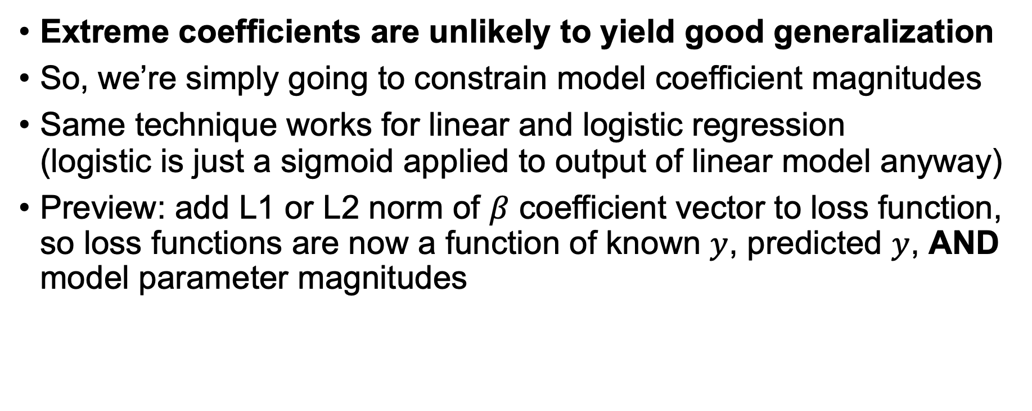
Regularization premise
Extreme coefficients are unlikely to yield good generalization
So, we’re simply going to constrain model coefficient magnitudes
Same technique works for linear and logistic regression (logistic is just a sigmoid applied to output of linear model anyway)
Preview: add L1 or L2 norm of $β$ coefficient vector to loss function, so loss functions are now a function of known $y$, predicted $y$, AND model parameter magnitudes

Slide 4
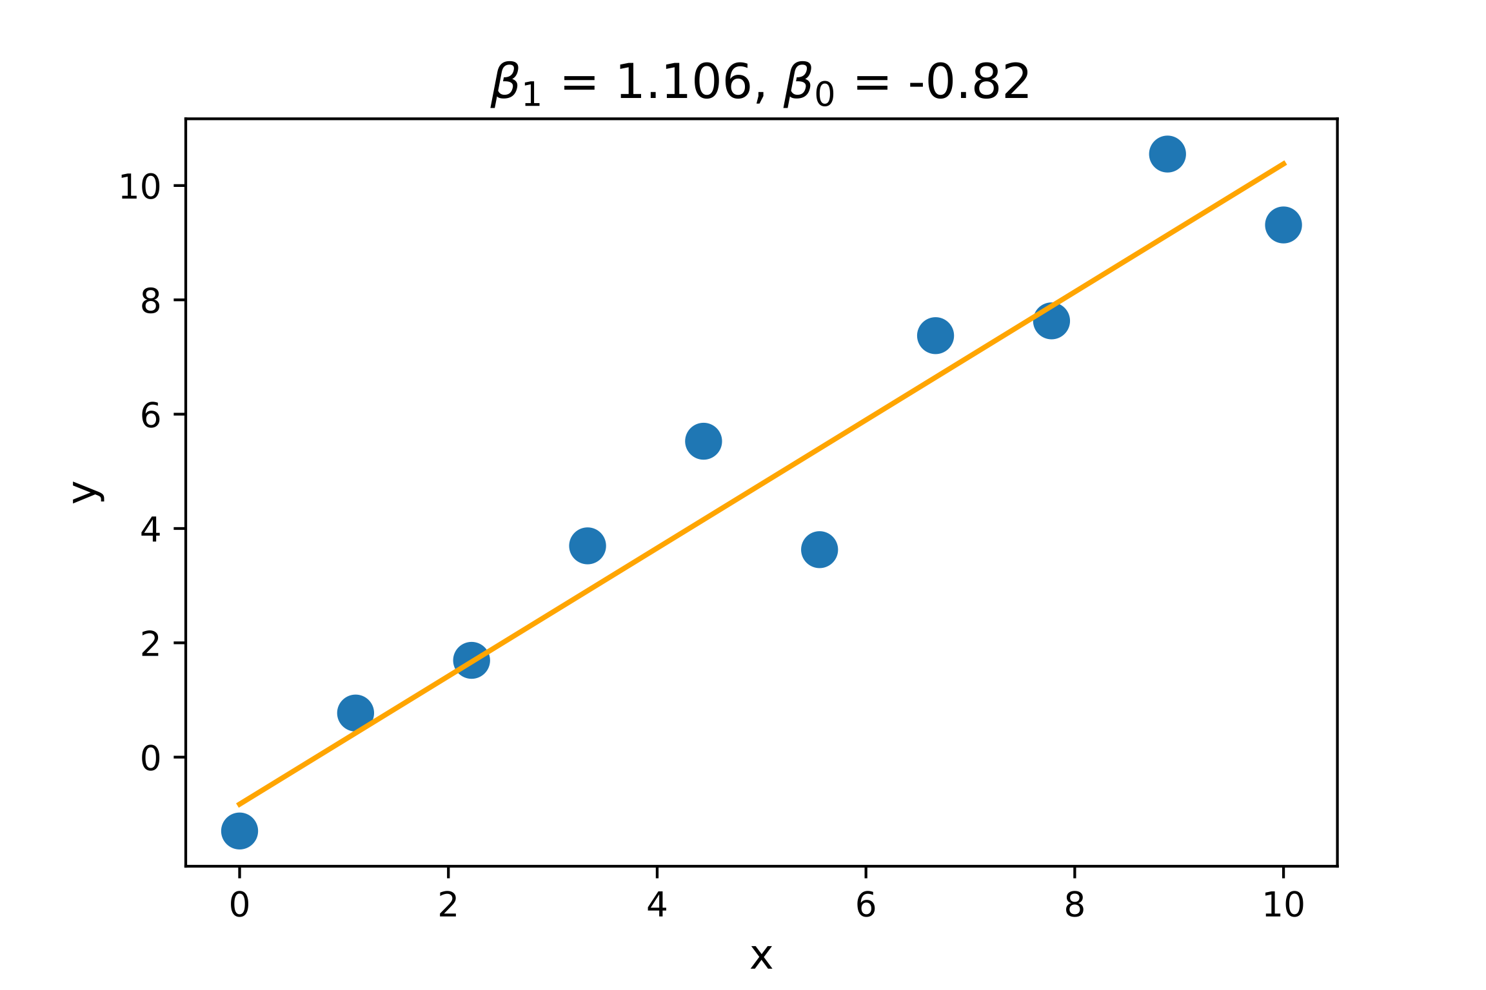
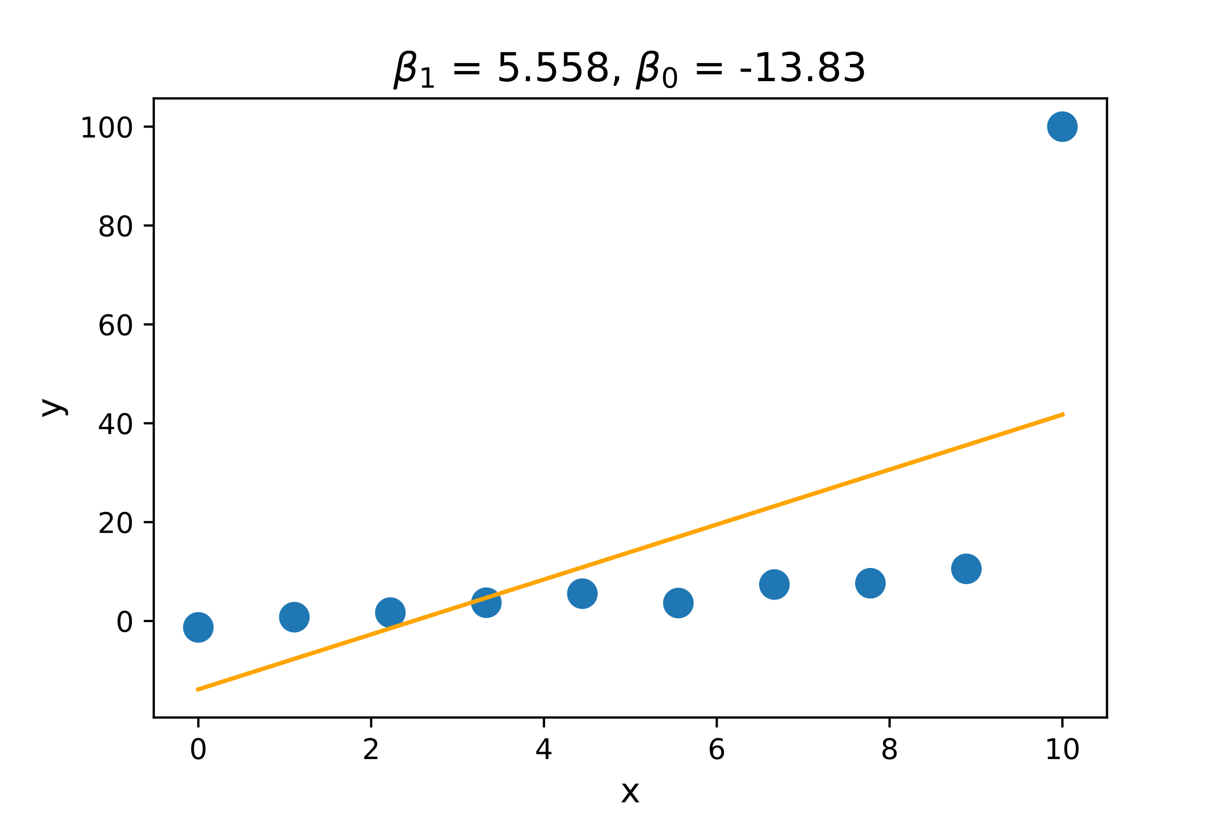
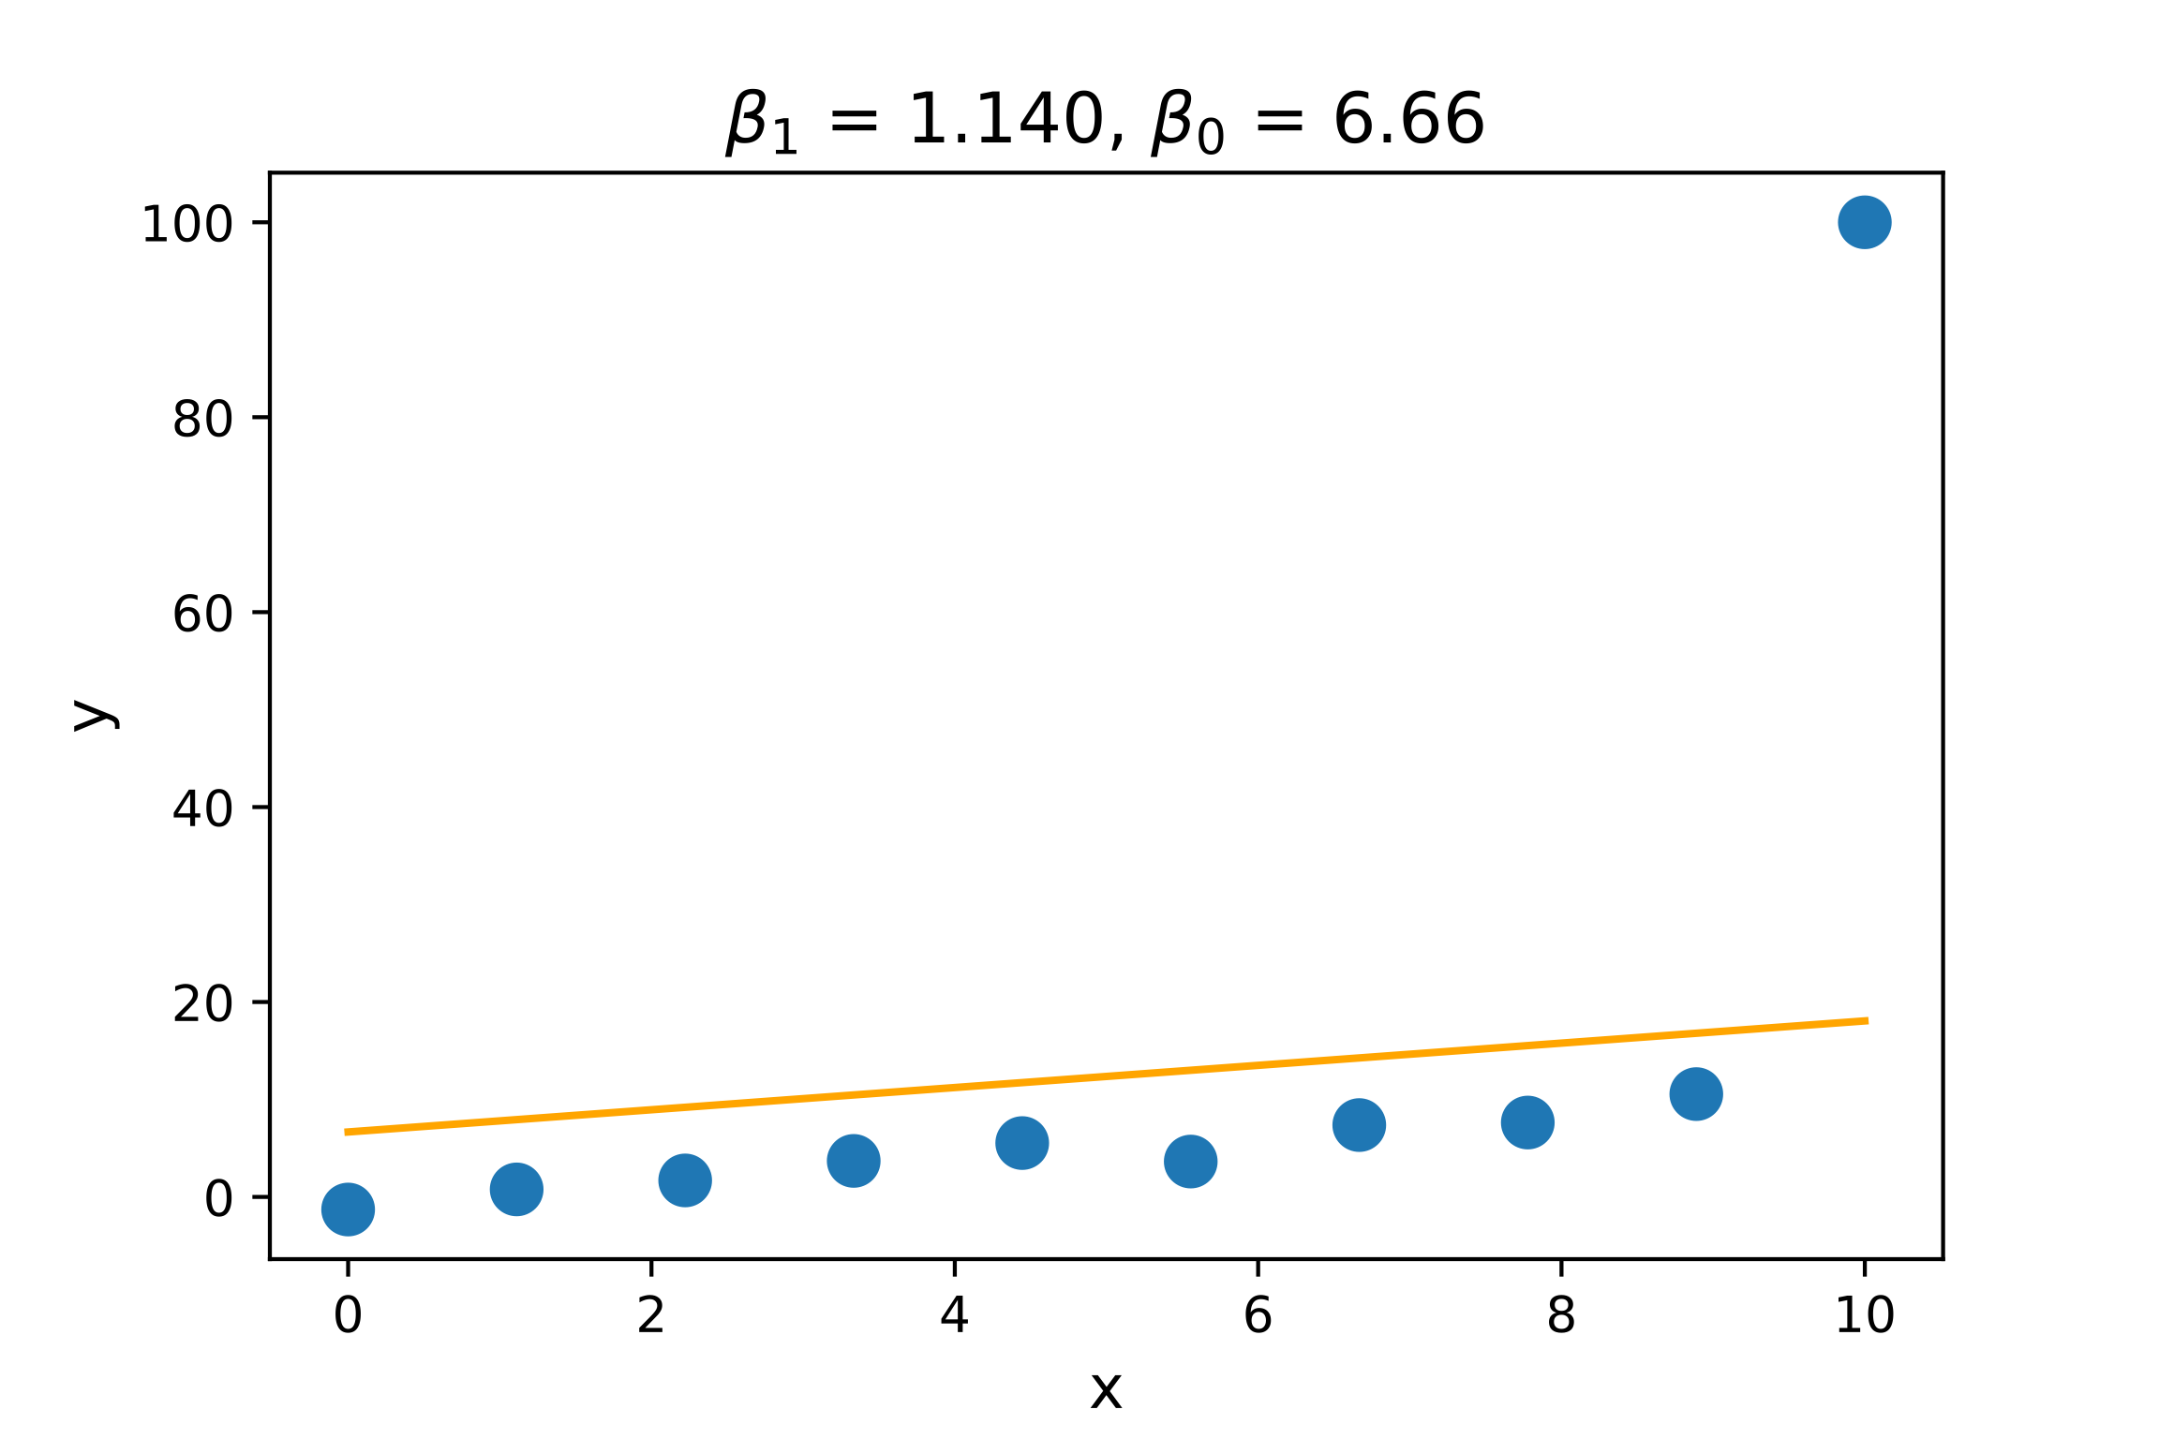
Let’s make a deal!
Let’s trade some model bias (accuracy) for improved generality
Consider an example of a simple data set with OLS fit
Now, send y[x==10] to 100; we get skewed line & bad R^2
Regularization brings slope back down but with some bias
Ordinary least squares
OLS with outlier
L1 regularization with outlier
Outlier

Slide 5
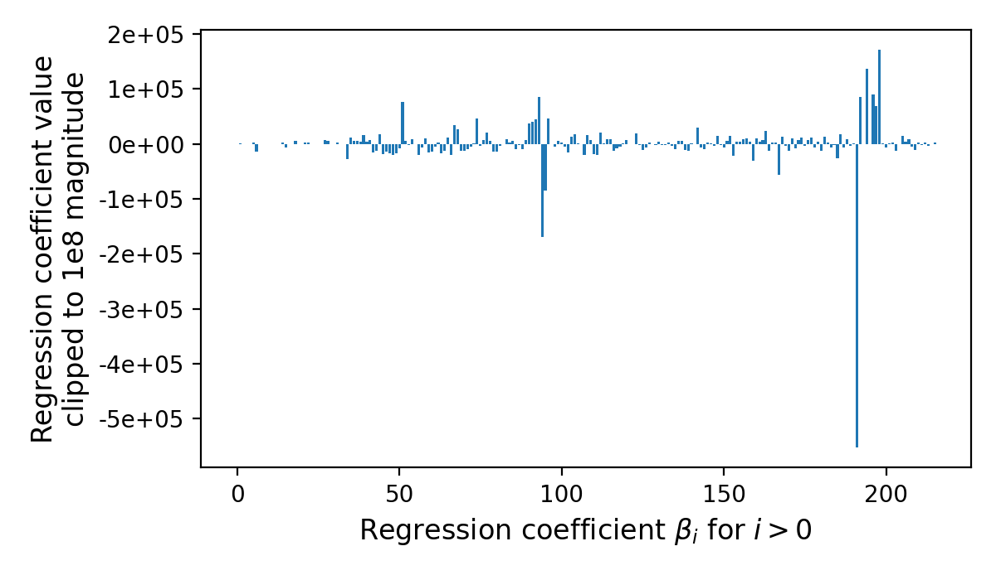
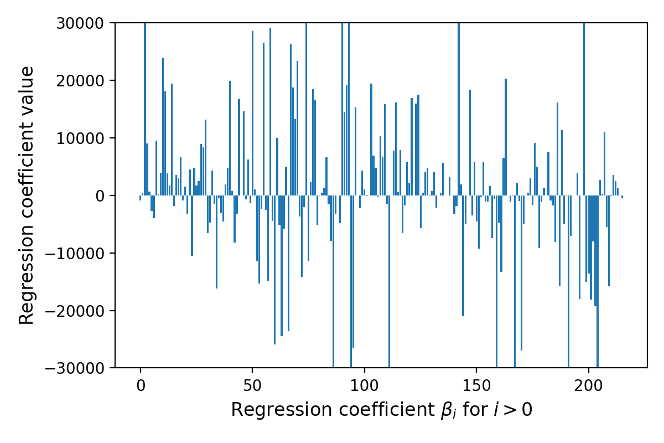
Ames housing data set (regressor)
With dummy vars, number of columns explodes from 81 to 216
Compare scale of coeff (huge coefficients don’t generalize)
Regressor test R^2 is -3e20 w/o regularization and ~0.85 with L1
See https://github.com/parrt/msds621/blob/master/notebooks/linear-models/regressor-regularization.ipynb

Slide 6
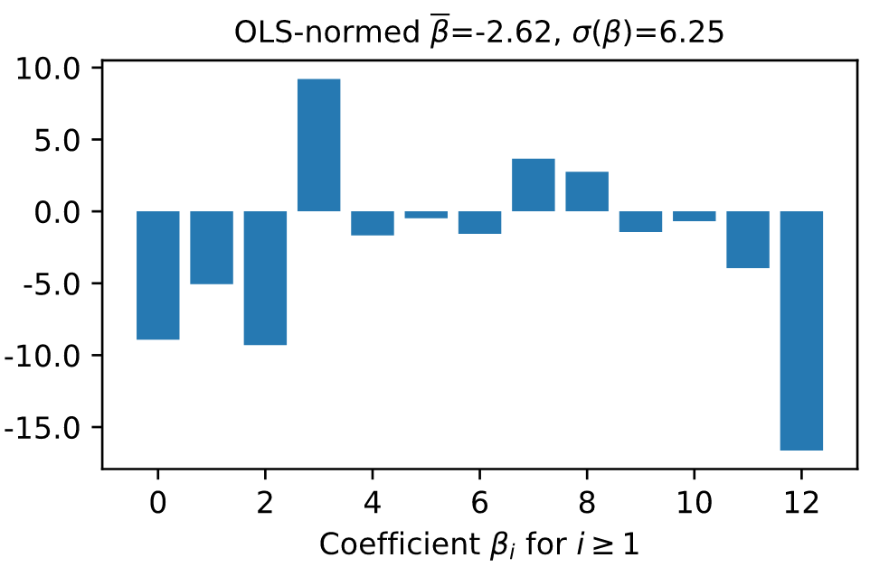
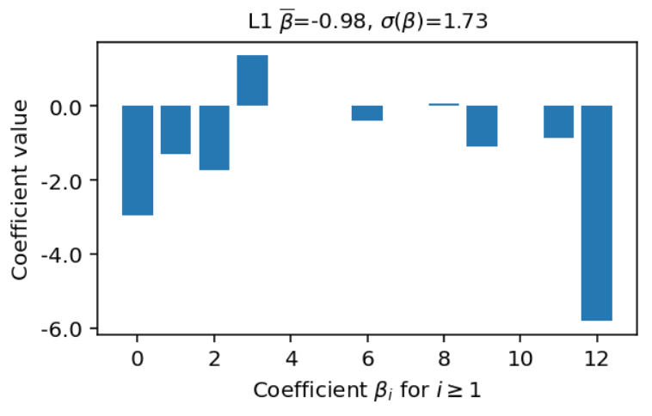
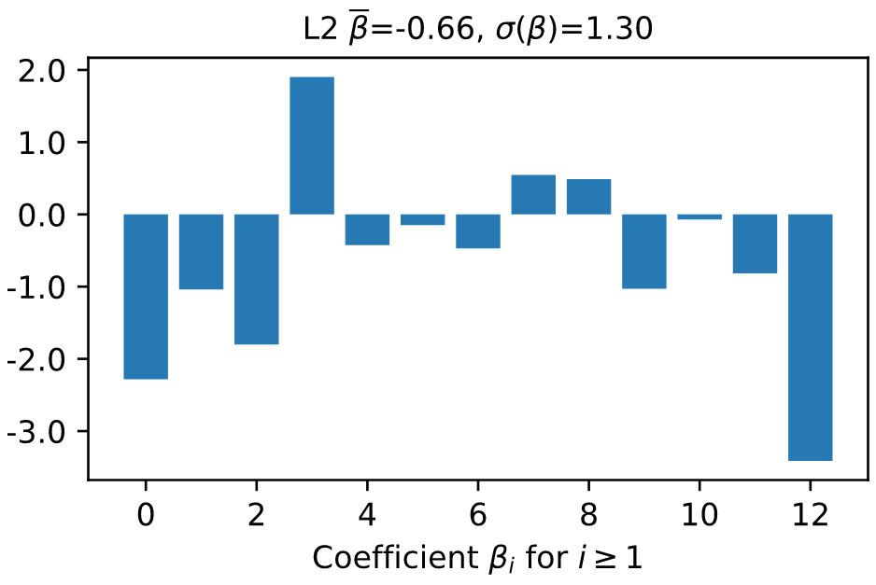
Wine classifier less accurate w/o reg.
Wine data set (130 records, 14 numeric vars)
Test accur=.96 (normalized data) w/OLS
L2 regularization 1.0 test score
L1 regularization .96 but can drop 4 coefficients from model
Normalized vars, OLS
L1 regularized
L2 regularized
See https://github.com/parrt/msds621/blob/master/notebooks/linear-models/classifier-regularization.ipynb

Slide 7
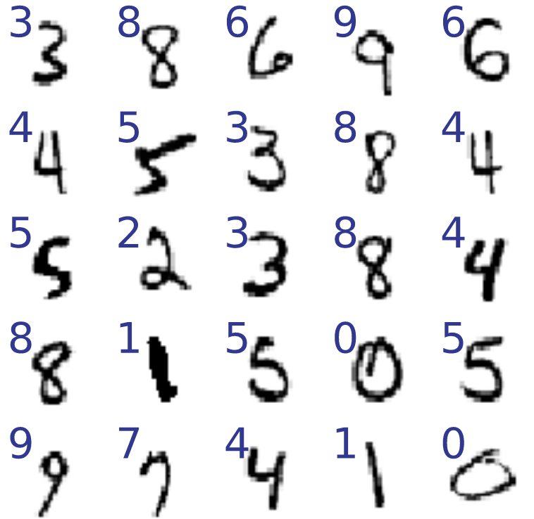
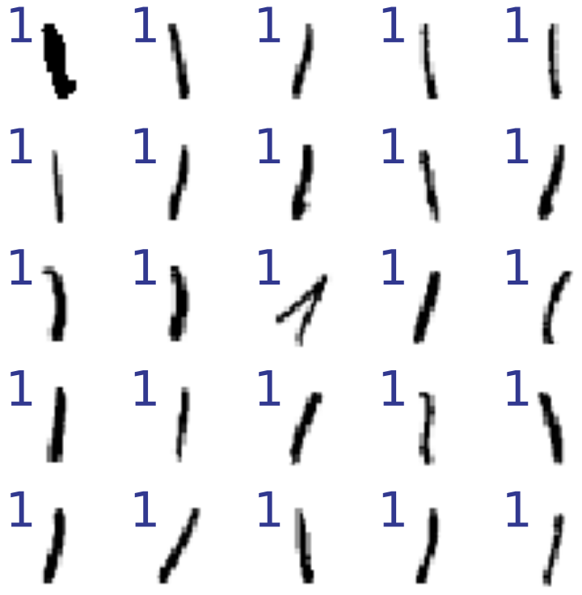
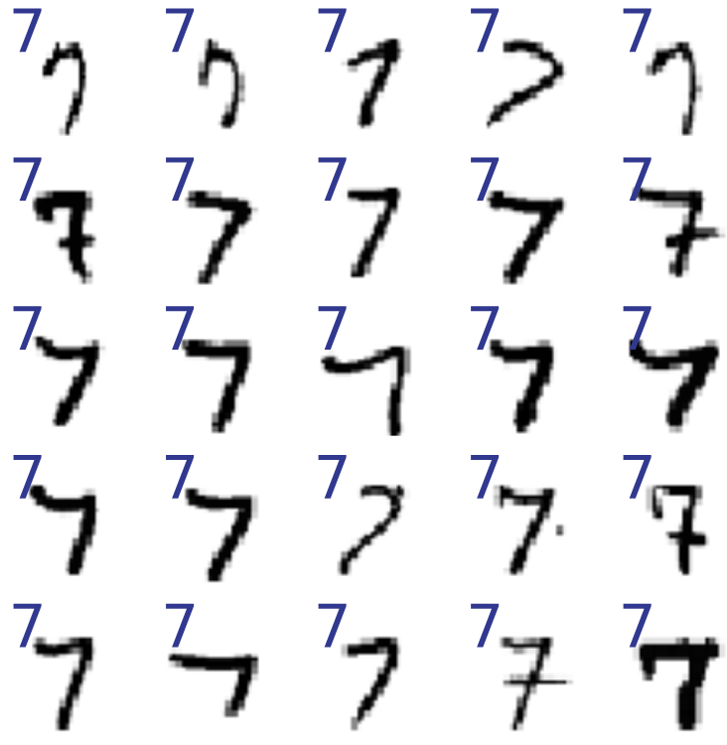
Example: classifier with many features
Distinguish between ones and sevens (MNIST dataset)
MNIST sample
ones sample
sevens sample
See https://github.com/parrt/msds621/blob/master/notebooks/linear-models/classifier-regularization.ipynb

Slide 8
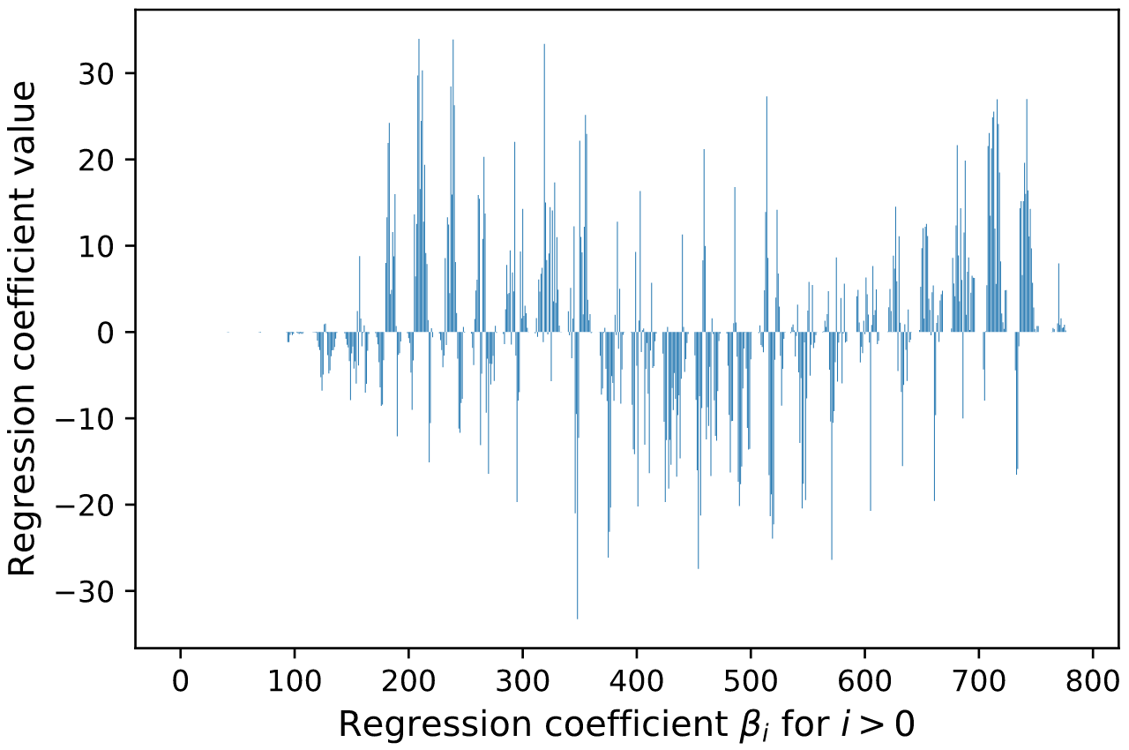
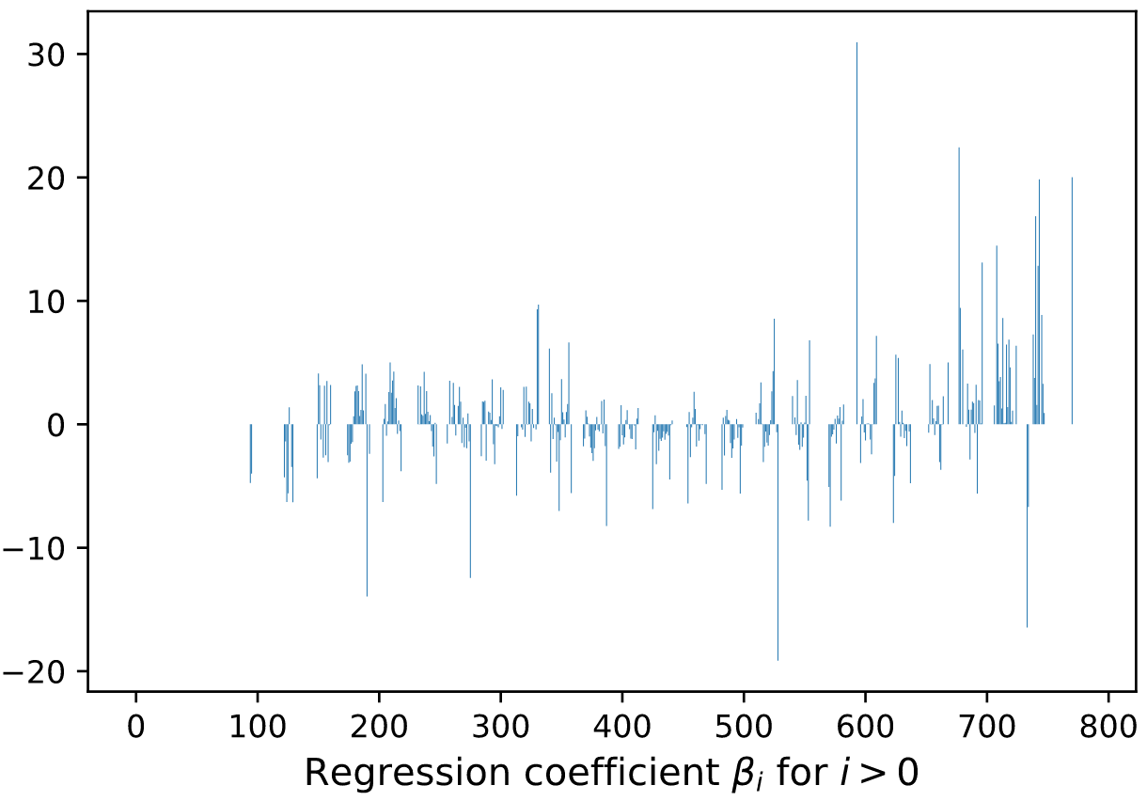
Compare coefficients w/o & with L1 reg
Test accur=96% w/OLS and L1 but log loss improves a lot
Also L1 regularization has zeroed out 423 coefficients and still accurate!
OLS logistic
L1 regularized logistic

Slide 9
Quick detour: Training models by walking downhill and normalizing data

Slide 10
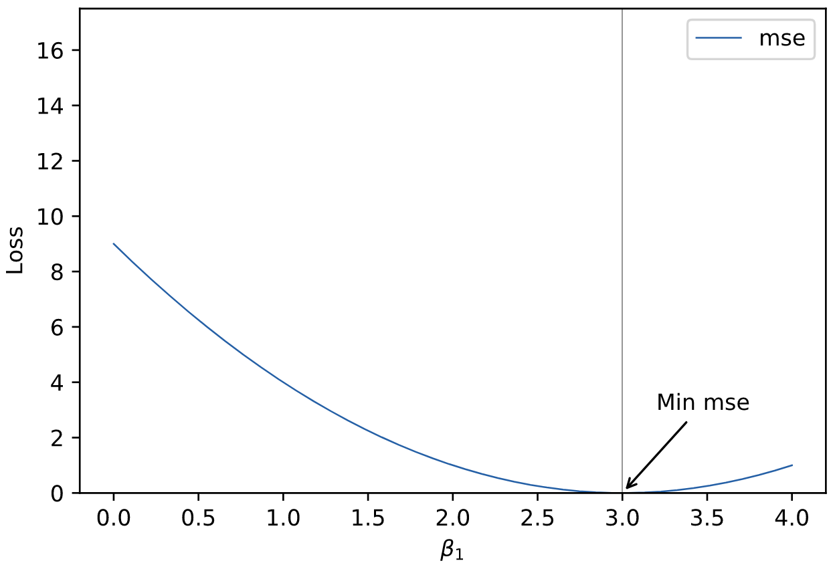

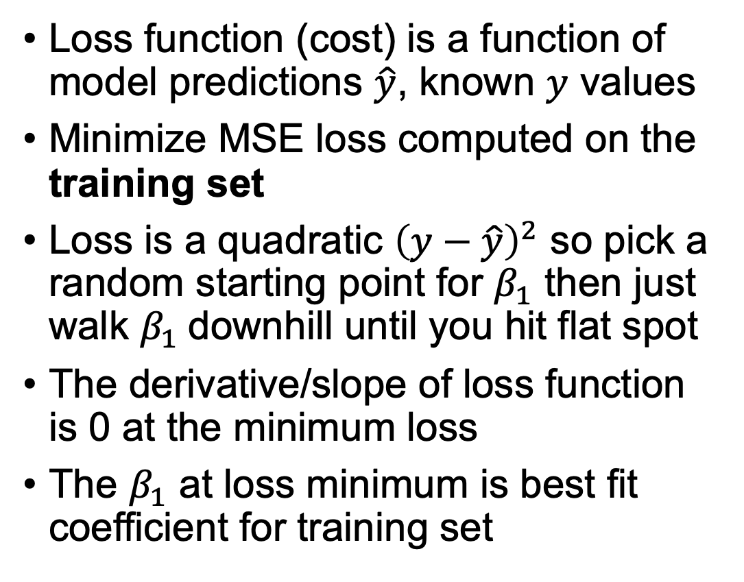
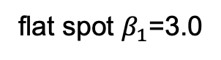
How (iterative) training works in 1 dimension
Loss function (cost) is a function of model predictions $\hat{y}$, known $y$ values
Minimize MSE loss computed on the training set
Loss is a quadratic ${\left(y−\hat{y}\right)}^{2}$ so pick a random starting point for $β_{1}$ then just walk $β_{1}$downhill until you hit flat spot
The derivative/slope of loss function is 0 at the minimum loss
The $β_{1}$ at loss minimum is best fit coefficient for training set
start here
flat spot $β_{1}$=3.0

Slide 11
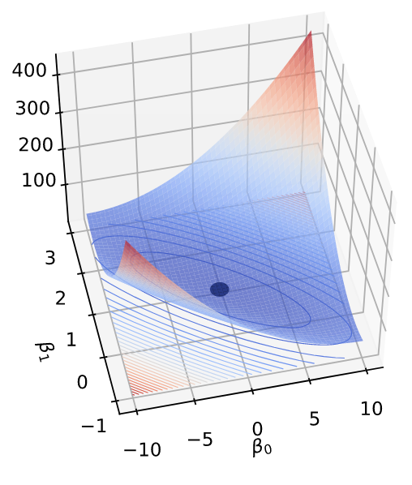
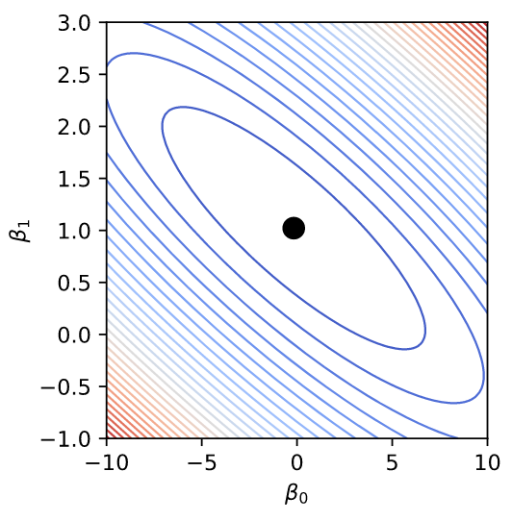
Training in 2D; loss function shape
We still walk downhill, but different directions can have different slopes
Move search "particle" in 2D to find coefficients associated with minimum loss
Think of dropping marble on surface and letting it roll down to low point
(We’ll have full lecture on gradient descent, don’t worry!)
See https://github.com/parrt/msds621/blob/master/notebooks/linear-models/viz-gradient-descent.ipynb

Slide 12
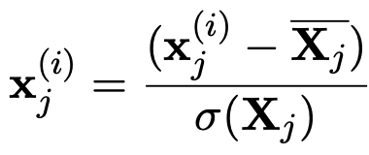
For training linear models, always normalize/standardize data
First, standardization leads to faster training
Second, regularization requires standardization, otherwise regularization shrinks coefficients disproportionately
Zero center each variable and divide by the standard deviation

Slide 13
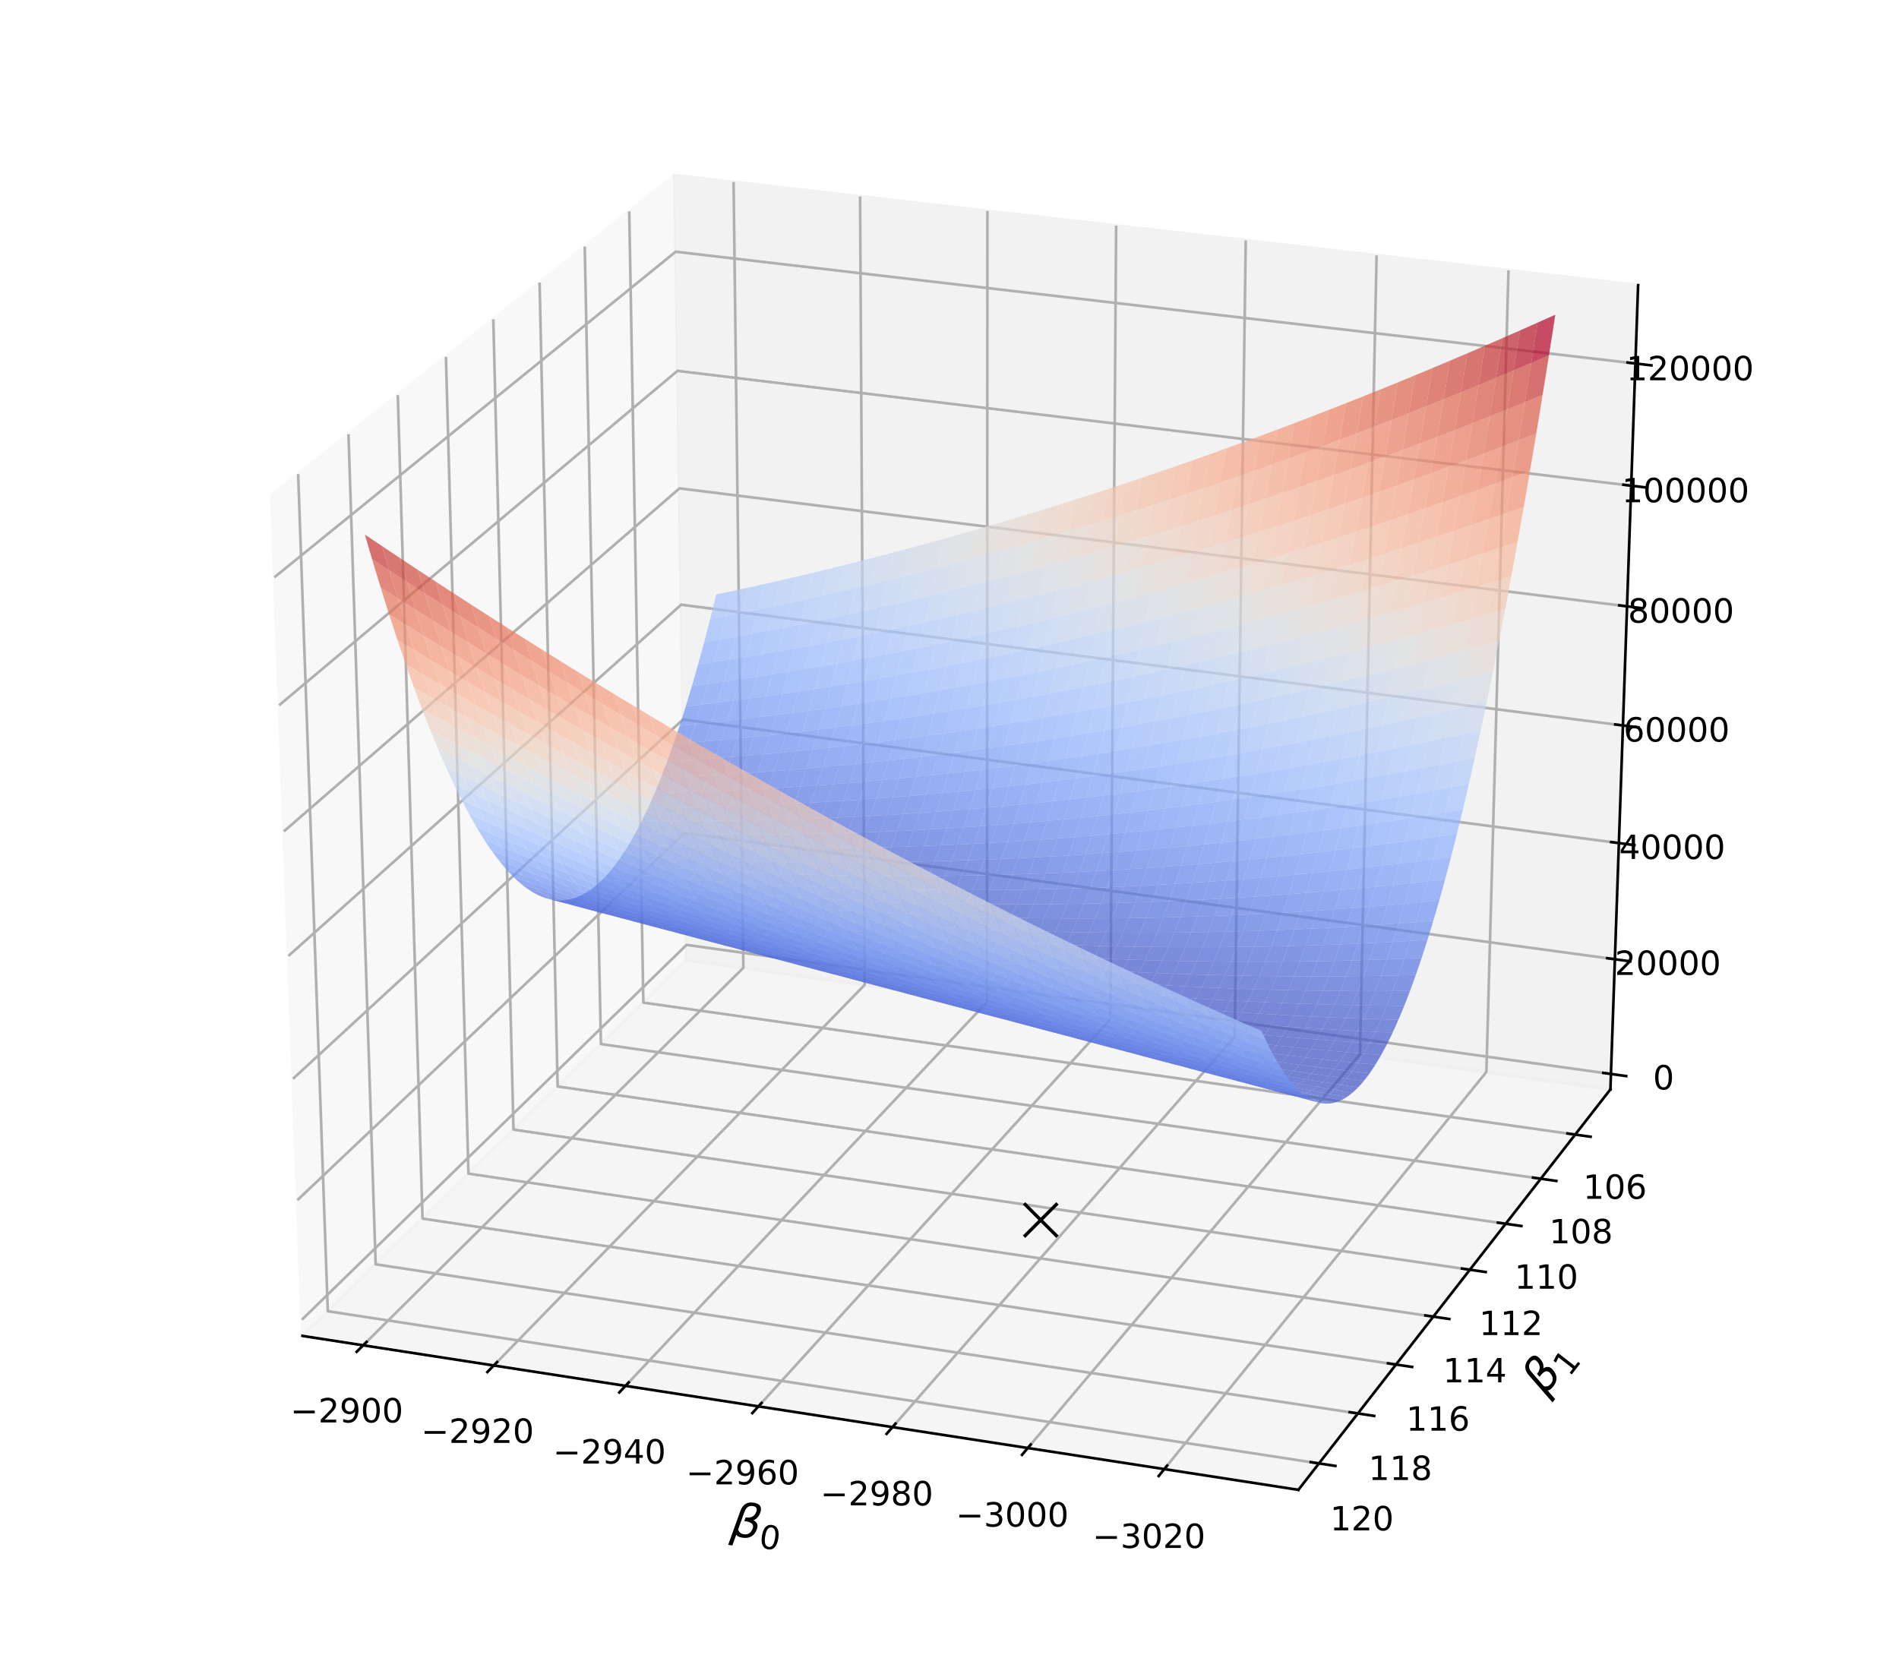
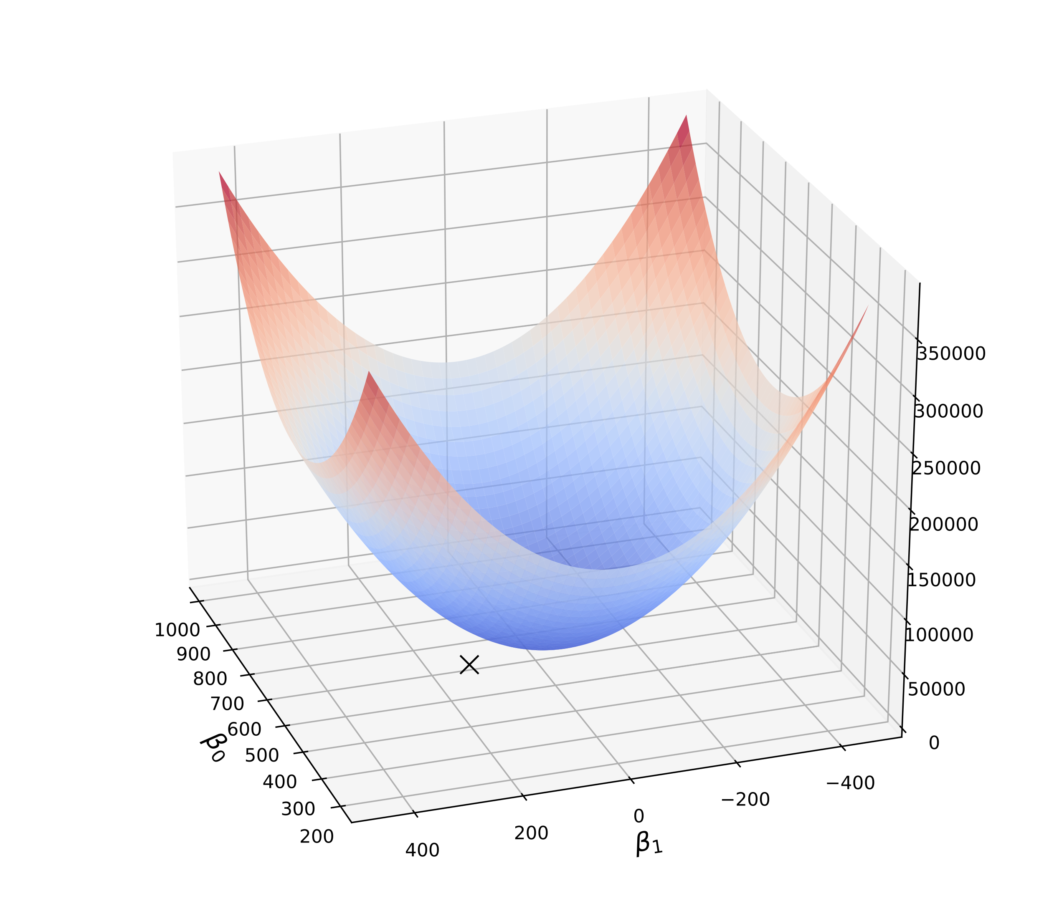
2D loss function shape for normalized vars
Untouched variables
Normalized variables
Cheese consumption vs bedsheet strangulation death data set
See https://github.com/parrt/msds621/blob/master/notebooks/linear-models/viz-gradient-descent.ipynb

Slide 14
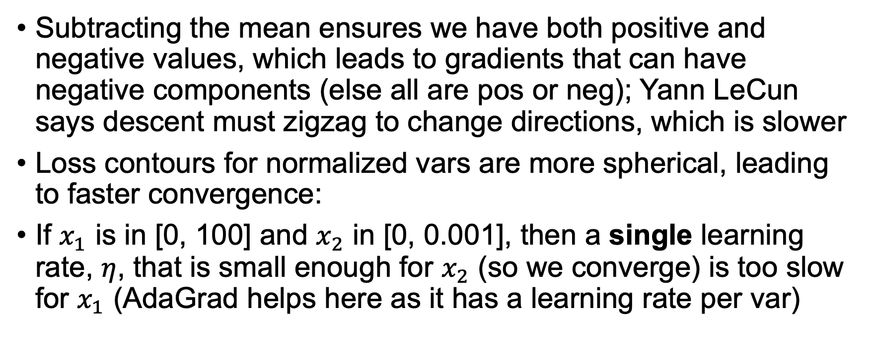
Standardization yields faster training
Subtracting the mean ensures we have both positive and negative values, which leads to gradients that can have negative components (else all are pos or neg); Yann LeCun says descent must zigzag to change directions, which is slower
Loss contours for normalized vars are more spherical, leading to faster convergence:
If $x_{1}$ is in [0, 100] and $x_{2}$ in [0, 0.001], then a single learning rate, $η$, that is small enough for $x_{2}$ (so we converge) is too slow for $x_{1}$ (AdaGrad helps here as it has a learning rate per var)
See http://yann.lecun.com/exdb/publis/pdf/lecun-98b.pdf

Slide 15
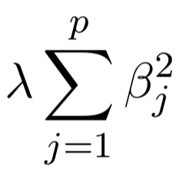
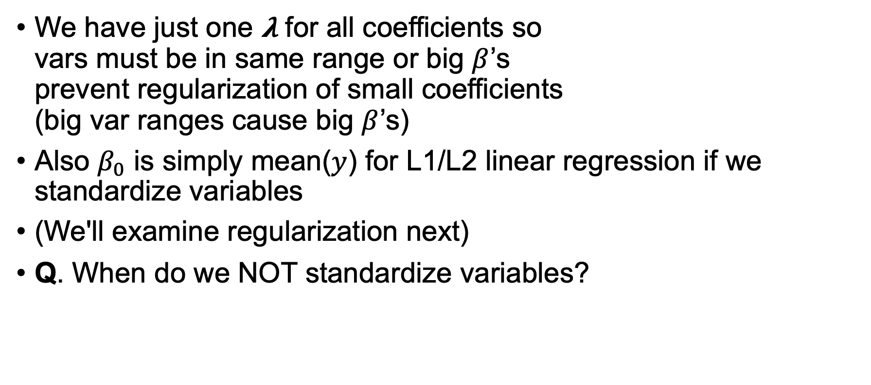
Must standardize for regularized training
We have just one 𝛌 for all coefficients so vars must be in same range or big $β$’s prevent regularization of small coefficients (big var ranges cause big $β$’s)
Also $β_{0}$ is simply mean($y$) for L1/L2 linear regression if we standardize variables
(We'll examine regularization next)
Q. When do we NOT standardize variables?
It's always safe to do it, but if all we care about is OLS predictive analytics, rather than analysis of parameters, then it's okay not to normalize; on the other hand we often need regularization for generalization purposes, which requires normalization

Slide 16
The regularization mechanism
The goal: Don’t let optimization get too specific to training data; inhibit best fit
The cost: Sacrifice some model accuracy (underfitting) for generality

Slide 17
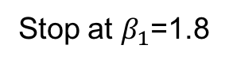
Simplest regularization
Just terminate minimization process early; don’t let the coefficients fully reach the minimal loss location
(Called early stopping in neural nets)
Walk “downhill” on training set loss curve until either:
You run out of AWS CPU credits
After fixed amount of time (you’re bored)
Loss on validation set (a moving avg thereof) starts going up, not down
stop here
after awhile
start here
Stop at $β_{1}$=1.8

Slide 18
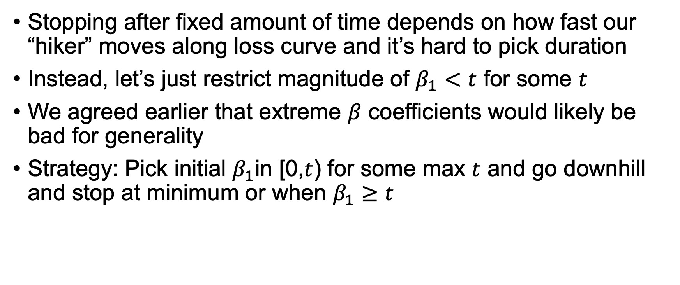
Improving early termination of training
Stopping after fixed amount of time depends on how fast our “hiker” moves along loss curve and it’s hard to pick duration
Instead, let’s just restrict magnitude of $β_{1}<t$ for some $t$
We agreed earlier that extreme $β$ coefficients would likely be bad for generality
Strategy: Pick initial $β_{1}$in [0,$t$) for some max $t$ and go downhill and stop at minimum or when $β_{1}≥t$

Slide 19
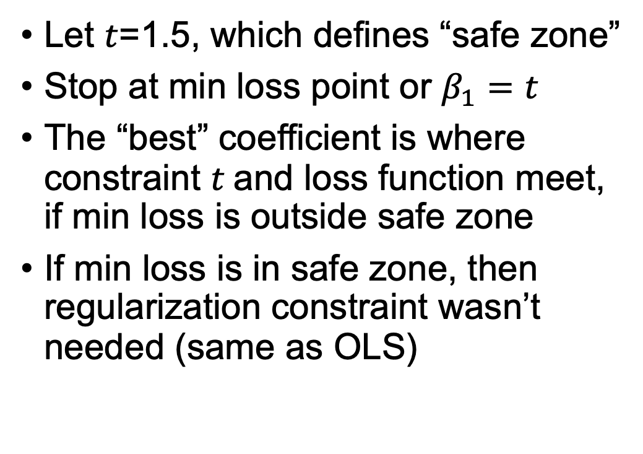
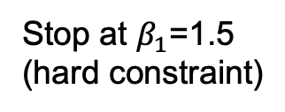
Minimizing loss, subject to a hard constraint
Let $t$=1.5, which defines “safe zone”
Stop at min loss point or $β_{1}=t$
The “best” coefficient is where constraint $t$and loss function meet, if min loss is outside safe zone
If min loss is in safe zone, then regularization constraint wasn’t needed (same as OLS)
safe zone
stop when
loss touches
constraint
start here
Stop at $β_{1}$=1.5 (hard constraint)

Slide 20
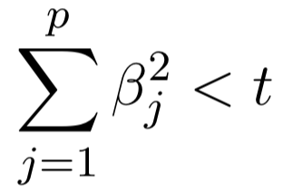
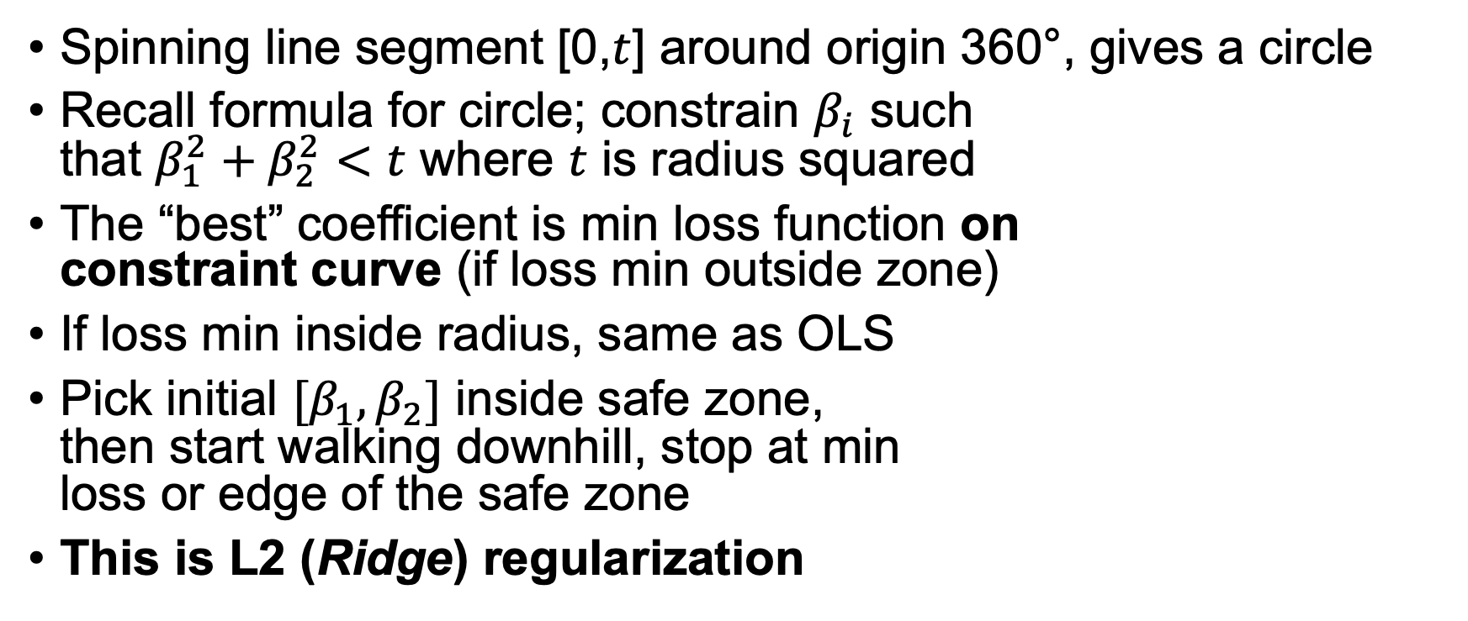
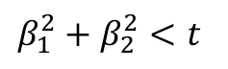
Minimizing in 2D subject to hard constraint
Spinning line segment [0,$t$] around origin 360°, gives a circle
Recall formula for circle; constrain $β_{i}$ such that $β_{1}^{2}+β_{2}^{2}<t$ where $t$ is radius squared
The “best” coefficient is min loss function on constraint curve (if loss min outside zone)
If loss min inside radius, same as OLS
Pick initial $[β_{1},β_{2}]$ inside safe zone, then start walking downhill, stop at min loss or edge of the safe zone
This is L2 (Ridge) regularization
Unconstrained
cost minimum
safe zone
$β_{1}^{2}+β_{2}^{2}<t$
Image credit: https://www.kdnuggets.com/2016/06/regularization-logistic-regression.html

Slide 21
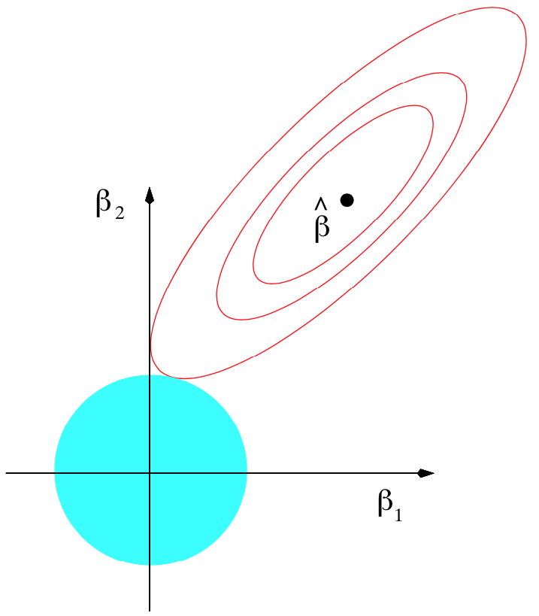
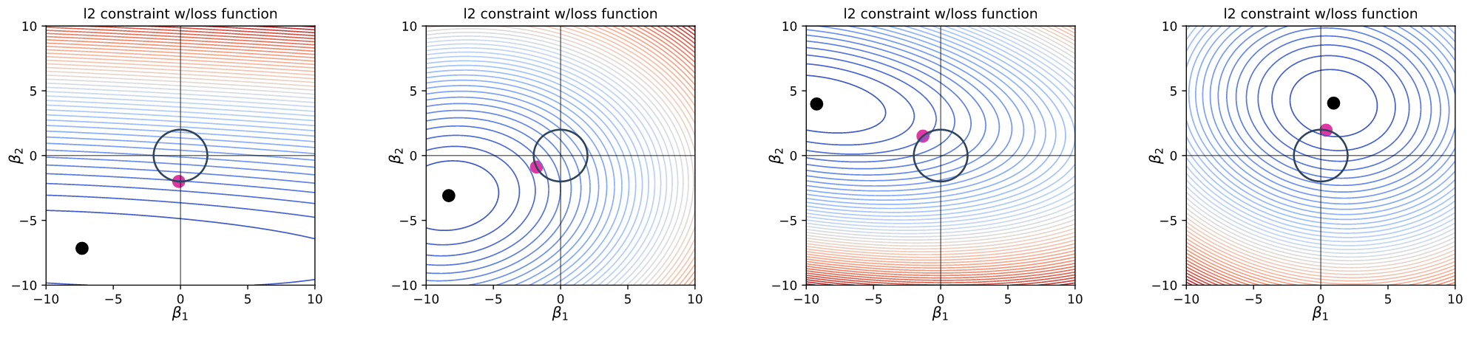
L2 regularization examples
The L2 regularized coefficients sit on the L2 boundary circle where the loss function has the minimum value.
Walk around the circle and identify the location with the minimum loss function value
Hard constraint
illustration from ESL page 71.
These are topo maps; see https://en.wikipedia.org/wiki/Topographic_map

Slide 22
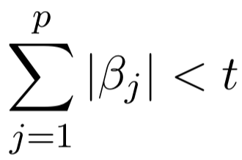
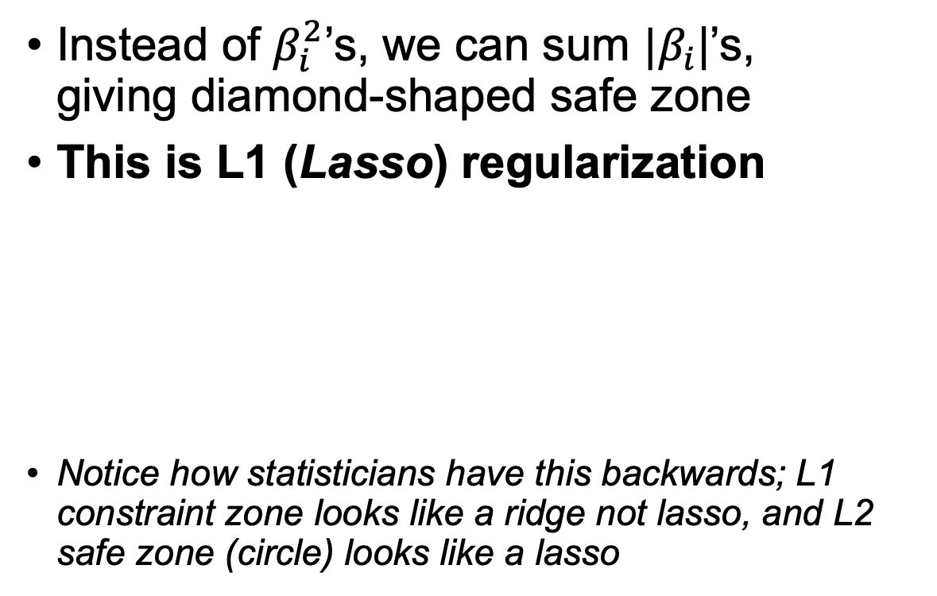
Minimizing L1 in 2D (hard constraint)
Instead of $β_{i}^{2}$’s, we can sum ${|β}_{i}$|’s, giving diamond-shaped safe zone
This is L1 (Lasso) regularization
Notice how statisticians have this backwards; L1 constraint zone looks like a ridge not lasso, and L2 safe zone (circle) looks like a lasso
safe zone
Constrained
loss minimum
🤪

Slide 23
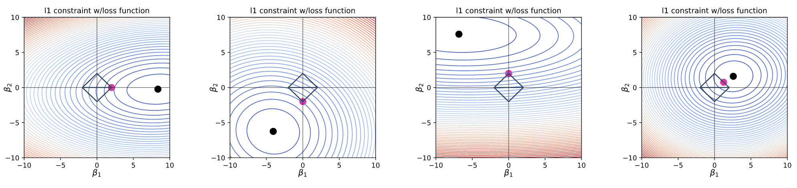
L1 regularization examples
The L1 regularized coefficients sit on the L1 boundary diamond where the loss function has the minimum value.
Walk around the diamond and identify the location with the minimum loss function value
Please note how often the red dot sits at a diamond corner, with a $β_{i}=0$

Slide 24
Questions
Do we want to make the model parameters as small as possible? E.g., are we trying to drive them to zero?
When do we choose L1 vs L2 regularization?
Is L1 always better than L2 or vice versa?
Is it okay to get rid of L1 parameters that go to zero?
We are constraining the coefficient magnitude rather than trying to drive them to 0; driving all to 0 would mean creating a model that always predicted 0
L1 when you want to reduce the number of features
Not that I have experienced
Sure; they don’t contribute to the regression (or classification)

Slide 25
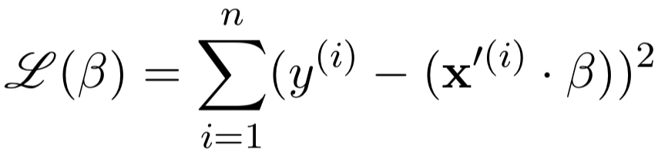
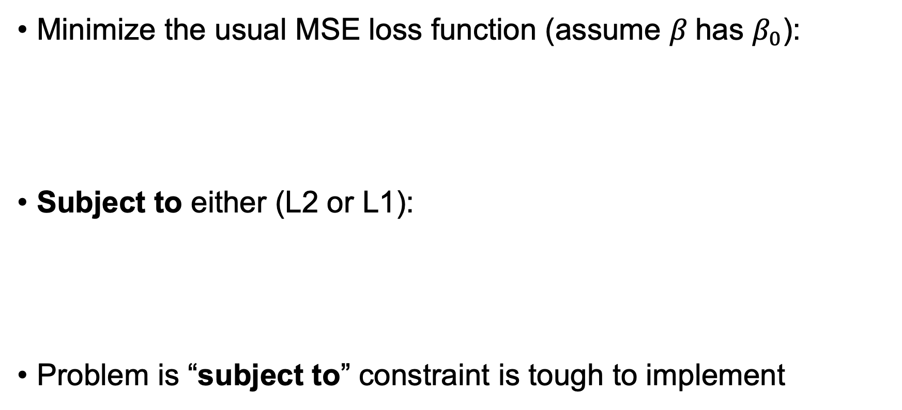
Fitting regularized linear models (Conceptually)
Minimize the usual MSE loss function (assume $β$has $β_{0}$):
Subject to either (L2 or L1):
Problem is “subject to” constraint is tough to implement
or

Slide 26
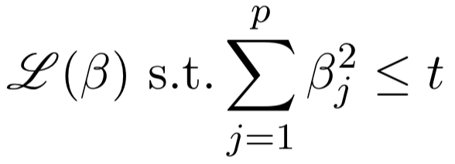
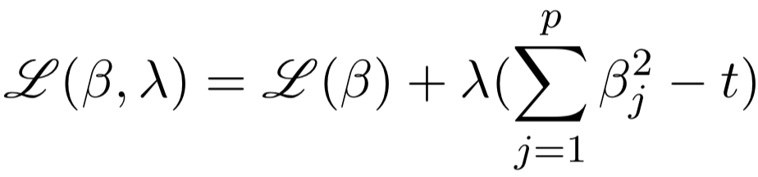
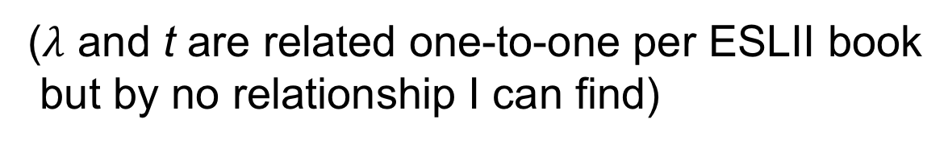
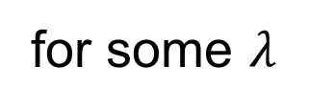
Detour: Lagrange Multipliers
Magic of Lagrange multipliers lets us incorporate constraint into loss function:
same as
for some $λ$
($λ$ and t are related one-to-one per ESLII book but by no relationship I can find)

Slide 27
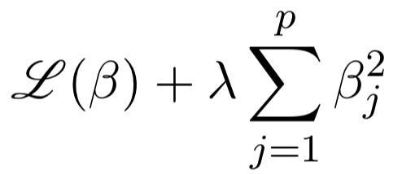
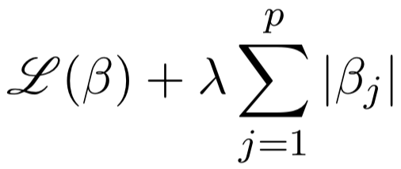
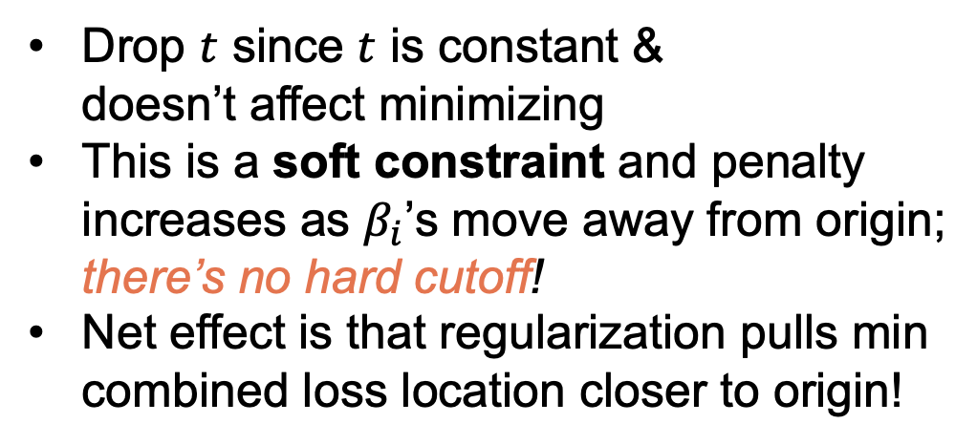
How we actually fit regularized models
Minimizing loss function subject to a constraint is more complicated to implement than just function minimization so…
Invoke magic of Lagrange multipliers:
For L2:
Drop $t$ since $t$ is constant & doesn’t affect minimizing
This is a soft constraint and penalty increases as $β_{i}$’s move away from origin; there’s no hard cutoff!
Net effect is that regularization pulls min combined loss location closer to origin!
For L1:

Slide 28
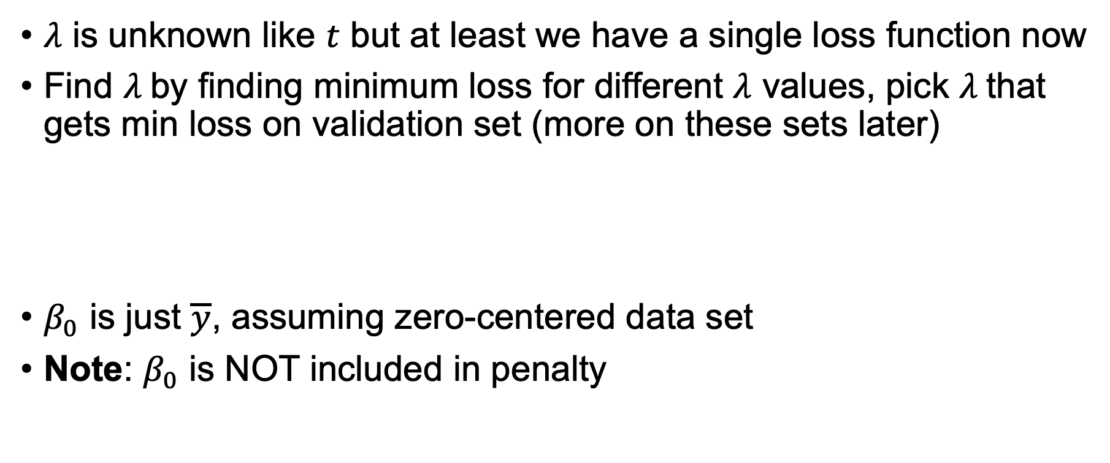
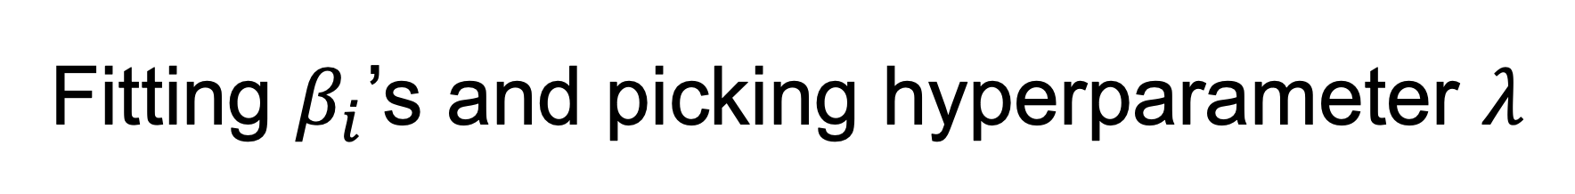
Fitting $β_{i}$’s and picking hyperparameter $λ$
$λ$ is unknown like $t$ but at least we have a single loss function now
Find $λ$by finding minimum loss for different $λ$ values, pick $λ$that gets min loss on validation set (more on these sets later)
$β_{0}$ is just $\overline{y}$, assuming zero-centered data set
Note: $β_{0}$ is NOT included in penalty

Slide 29
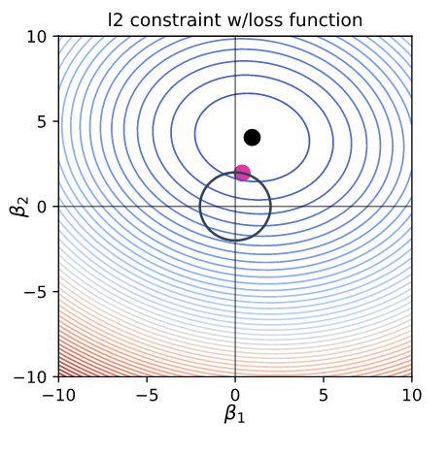
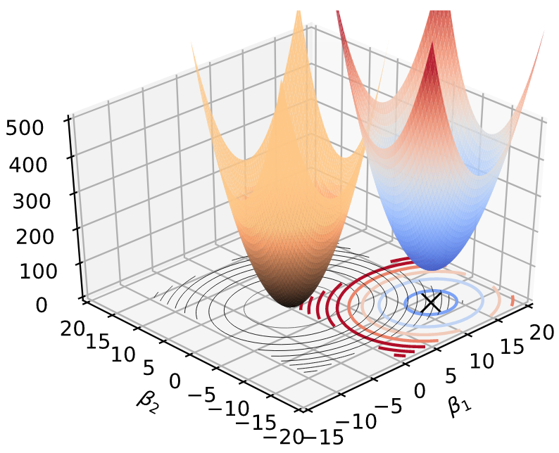

Hard vs soft constraints in 2D
Hard constraint
Soft constraint
Constrained loss function
Sum of loss and penalty functions
See https://explained.ai/regularization/index.html

Slide 30




1D example of loss+penalty curves
L1 $β_{1}$ can quickly converge to 0 for large $λ$
L2 $β_{1}$ struggles to converge to 0 for large $λ$
See https://github.com/parrt/msds621/blob/master/notebooks/linear-models/viz-regularization.ipynb

Slide 31



Affect of $λ$ on combined loss function
MSE loss function + soft constraint as $λ$varies from 0 to 6
Same training data so MSE loss surface is the same
Only $λ$ is changing here, increasing penalty for same $β_{i}$ coefficients
Combined loss function moves upwards and towards the origin
See https://explained.ai/regularization/index.html

Slide 32



How penalty term restricts $β_{i}$’s
Think of regularization as two different cost functions, MSE and regularization, added together
Regularization penalty term increases loss but skews min loss $β_{i}$ location towards origin as penalty curve is anchored at origin
Soft constraint makes larger $β_{i}$ very unlikely due to increased penalty away from origin (whereas hard constraint makes large coefficients > $t$ impossible)
L1&L2 shift $β_{i}$’s towards 0 because penalty approaches 0 only at $β$=0
penalty term
L2

Slide 33


The effect of regularization
Regularization is turned off
What happens when 𝛌 is 0?
What happens when we crank up 𝛌?
L1 tends to shrink coefficients to zero; useful for feature selection since we can drop features with zero coefficients
L2 tends to shrink coefficients evenly; discourages any single $β_{i}$ from getting much bigger than the others
L2 useful when you have collinear/codependent features
e.g., gender and ispregnant
codependence tends to increase coefficient variance, making coefficients unreliable/unstable, which hurts model generality
L2 reduces the variance of these coefficient estimates
Loss function strives for small $\text{β}$

Slide 34
Comparing L1 and L2 regularization

Slide 35


L1 regularization encourages coefficients=0
See https://explained.ai/regularization/L1vsL2.html
L1 has many more zero parameters than L2 for symmetric loss functions
Simulate random symmetric two-variable quadratic loss functions at random locations
Dots: loss function minimum locations; green: a zero coefficient, blue no zeros, orange a coeff close to 0
L1
L2
See https://explained.ai/regularization/index.html

Slide 36

L1 regularization strongly encourages zero coefficients for less predictive features
Imagine one of two features is very important and the other isn't
Implies loss function looks like a taco shell or canoe, and at or close to 90 degrees to one of the axes
Movement in one direction is much more expensive than movement in the other

Slide 37


Random asymmetric, angled loss functions
L1 still has many more zero parameters than L2 for arbitrary loss functions
L1
L2

Slide 38


Why L1 is more likely to zero coefficients than L2
Moving away from the L1 diamond point immediately increases loss
L2 can move upwards a bit before moving leftward away from loss function minimum
As black dot approaches $β_{1}$ axis, L2 purple dot approaches $β_{1}$ axis, but L1 gets $β_{2}=0$ even when loss min location far from axis
Contour lines represent the
same loss function value
See https://explained.ai/regularization/index.html

Slide 39
Lab time
Exploring regularization for linear regression https://github.com/parrt/msds621/tree/master/labs/linear-models/regularization-regr.ipynb

Slide 40
Regularized logistic regression

Slide 41




Optimizing likelihood with penalty terms
(Logistic regularization is not required for your project, but L1 is an option)
Same mechanism: minimizing (negation of maximum likelihood) via Lagrangian interpretation:
L2
L1
Note: $β_{0}$ is NOT included in penalty, but is used in term (want to constrain slopes not y-intercept)

Slide 42



Fitting L1 logistic regression $β_{i}$’s and picking $λ$
ESLII book p125 says to find L1 $β_{0}$ and $β_{1..p}$ that maximize:
We minimize the negative of that to find $β$ with min loss
Means we must find $β_{0}$ differently than for $β_{1..p}$
As before, find $λ$by computing minimum loss for different $λ$ values, pick $λ$that gets min loss on validation set
L1 Logistic gradient is tricky to get right; see gradient descent lecture

Slide 43
Resources with code
https://aimotion.blogspot.com/2011/11/machine-learning-with-python-logistic.html
https://stackoverflow.com/questions/38853370/matlab-regularized-logistic-regression-how-to-compute-gradient
You may look at but not cut-paste from these examples for your project (and I think there are some bugs too)

Slide 44

Key takeaways
Regularization increases generality at cost of some bias
Does so by restricting size of coefficients with hard constraint (conceptually) or soft constraint using penalty term (impl.)
For hard constraint, min loss is inside safe zone or on zone border
Soft constraint penalty discourages bigger parameters
L2 discourages any$β_{i}$ from getting much bigger than the others
L1 encourages zero $β_{i}$; in practice, we see L1 zero out unpredictive vars

Slide 45


Key implementation details
Minimize by trying multiple $λ$ and choosing parameters from fitted model getting lowest validation error
Normalize numeric variables in $X$ before fitting linear models
If 0-centered $x_{i}$ then $β_{0}=mean(y)$ for L1 and L2 regression
Logistic regression has no closed form for $β_{0}$
OLS & L2 regularized linear regression have symbolic solutions
L1 linear regression and L1/L2 logistic regression require iterative solution: usually some gradient descent variation

Slide 46

Interview questions (L1 vs L2)
Both L1 and L2 increase bias (reduce ”accuracy” of fit, predictions)
L1 useful for variable / feature selection as some $β_{i}$ go to 0
L2 much less likely to get zero coefficients
L2 useful when you have collinear features (e.g., both tumor radius and tumor circumference features)
Collinearity increases coefficient variance, making them unreliable
And L2 reduces variance of $β_{i}$ estimate which counteracts effect of collinearity
With regularization, we don’t get unbiased $β_{i}$ estimates
Expected value of $β_{i}$ estimate is no longer $β_{i}$ since we’ve constrained $β_{i}$’s
Consequence: we no longer know effect of $x_{i}$ on target $y$ via $β_{i}$
In my experiments, regularization improves regression much more than classification in terms of R^2 and simple accuracy; (due to sigmoid constraining the solutions to the loss function?)

Slide 47
Lab time
Regularization for logistic regression https://github.com/parrt/msds621/blob/master/labs/linear-models/regularization-logi.ipynb

